Slide 2
6 Locations
Pipestone, MN
Independence, IA
Orange City, IA
Ottumwa, IA
DeKalb, IL
Rensselaer, IN
Industry leader in biosecurity, applied research, and filtration.
Offerings:
Traditional Veterinary Service
Production and/or Health Consulting
Filter design and compliance
Animal health product sourcing
Biosecure sow farm delivery options
PART (Pipestone Antibiotic Resistance Tracker)

Slide 3
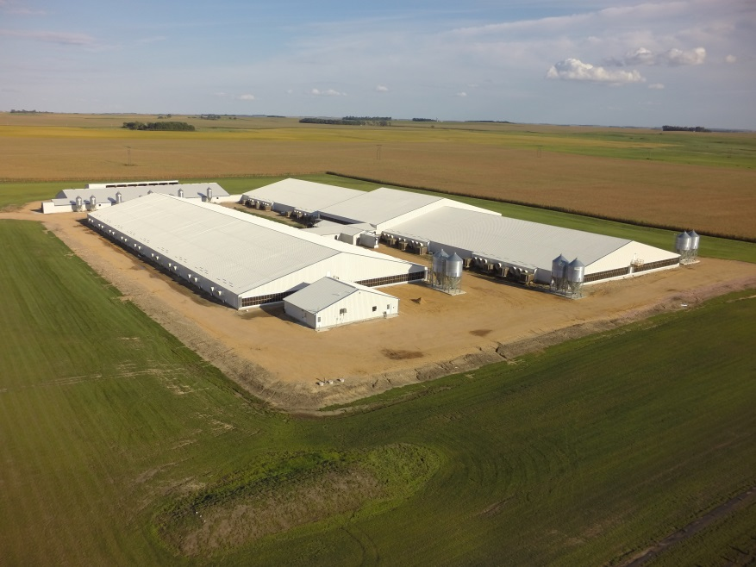
Coordinate Sow Farm Ownership Groups
Farms are owned by independent pork producers
16 farms in South Dakota
1,000+ team members
Building Process
Find suitable land for building
Complete permitting process
Experts in barn design
Services
Sow Farm Management
Employees
Standard Operating Procedure
Production Expertise
Information
Detailed financial reports
Detailed production reports
Benchmark

Slide 4
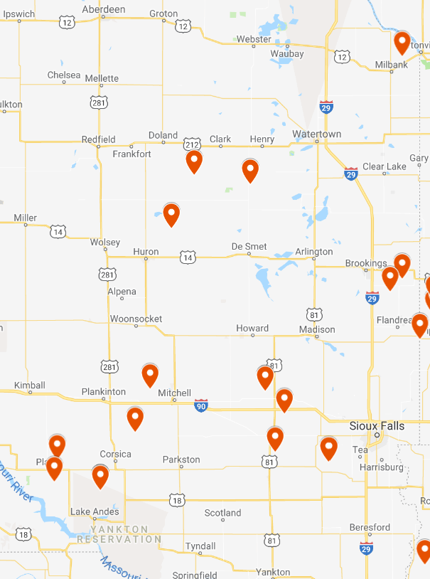
Pipestone System Sow Farms South Dakota Locations
PS Farms in Production
PS Farms under Construction

Slide 5
Helping Farmers Today Create the Farms of Tomorrow

Slide 6
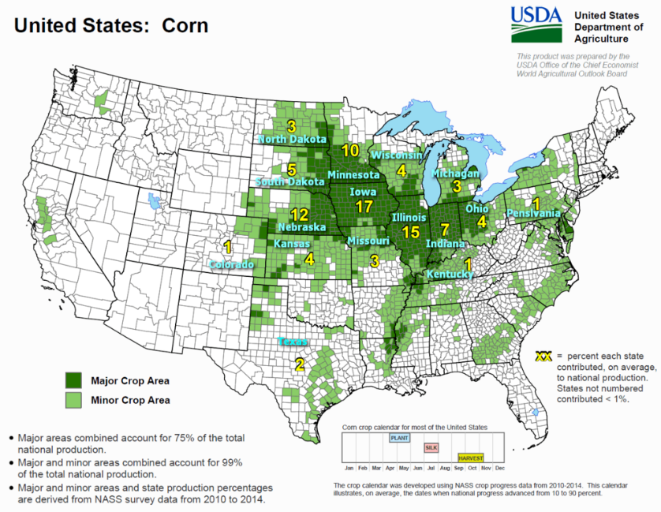
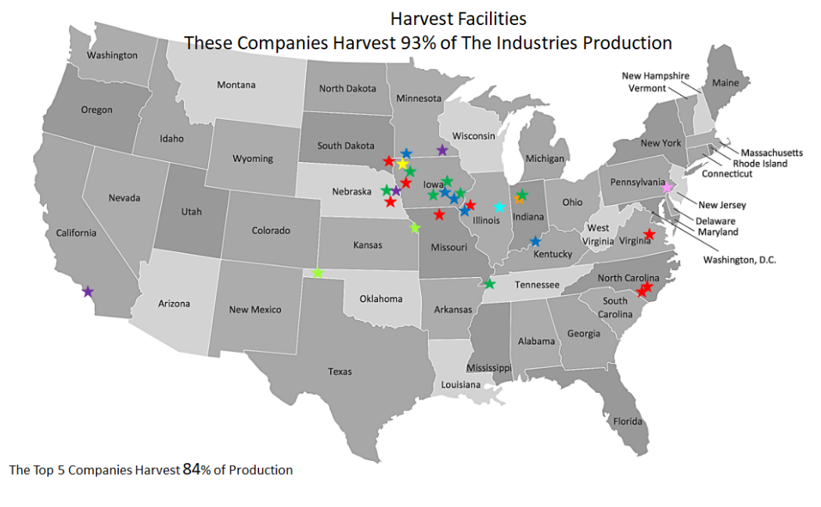
Why South Dakota?
Agriculture communities
Grain availability, Packing plant accessibility
Low population density
Access to good work ethics and animal husbandry skills
Available workforce- unemployment rate 3.2% (Jun. ‘18)

Slide 7
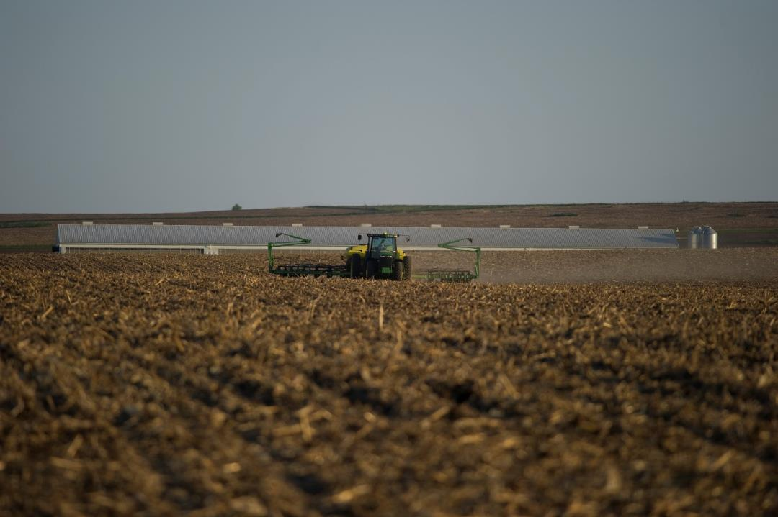
Our process to build a farm…
Pig producers wanting sow ownership, downstream flow (460+ Shareholders today…)
Land availability meeting state, local requirements
Permitting process
State Application
Water Rights
Pollution Control
DENR Nutrient Management Plan
Conditional Use Permit
Construction
Farms are engineered to meet local
and state regulation
Production

Slide 8
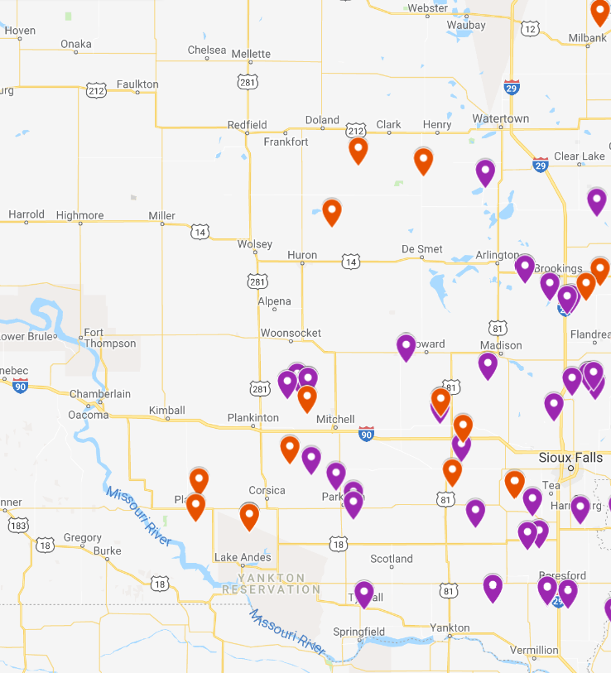
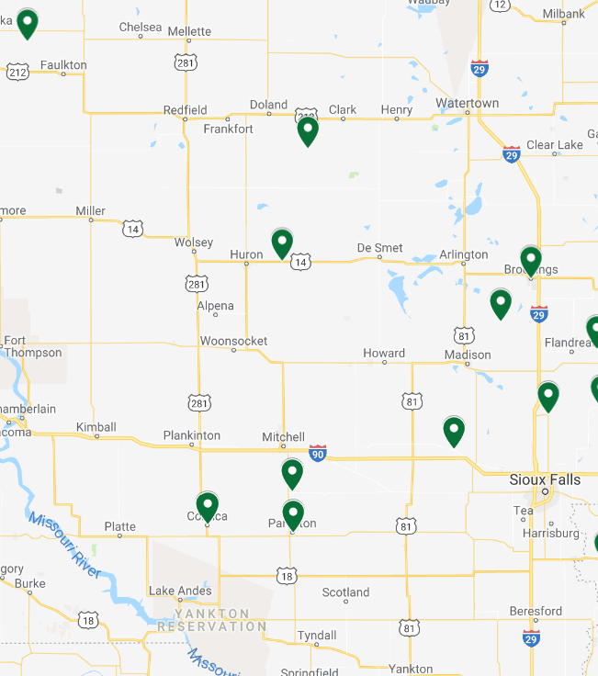
Managed GF Space: 85K Spaces
Feed Mills: 11 Locations

Slide 9
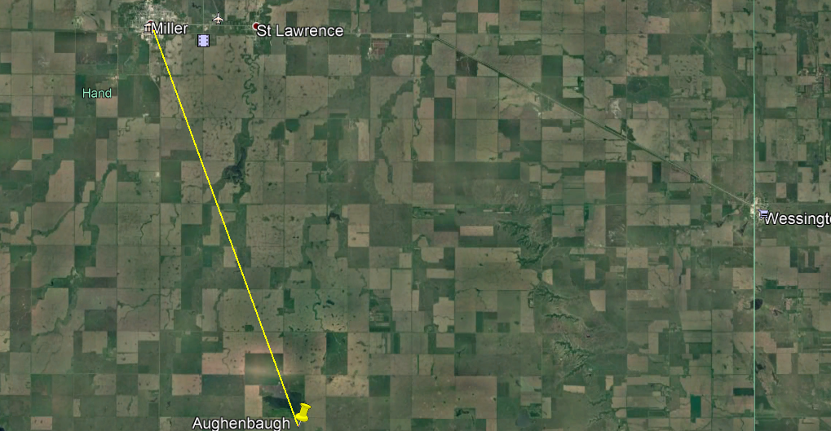
~9.9 miles southeast

Slide 10
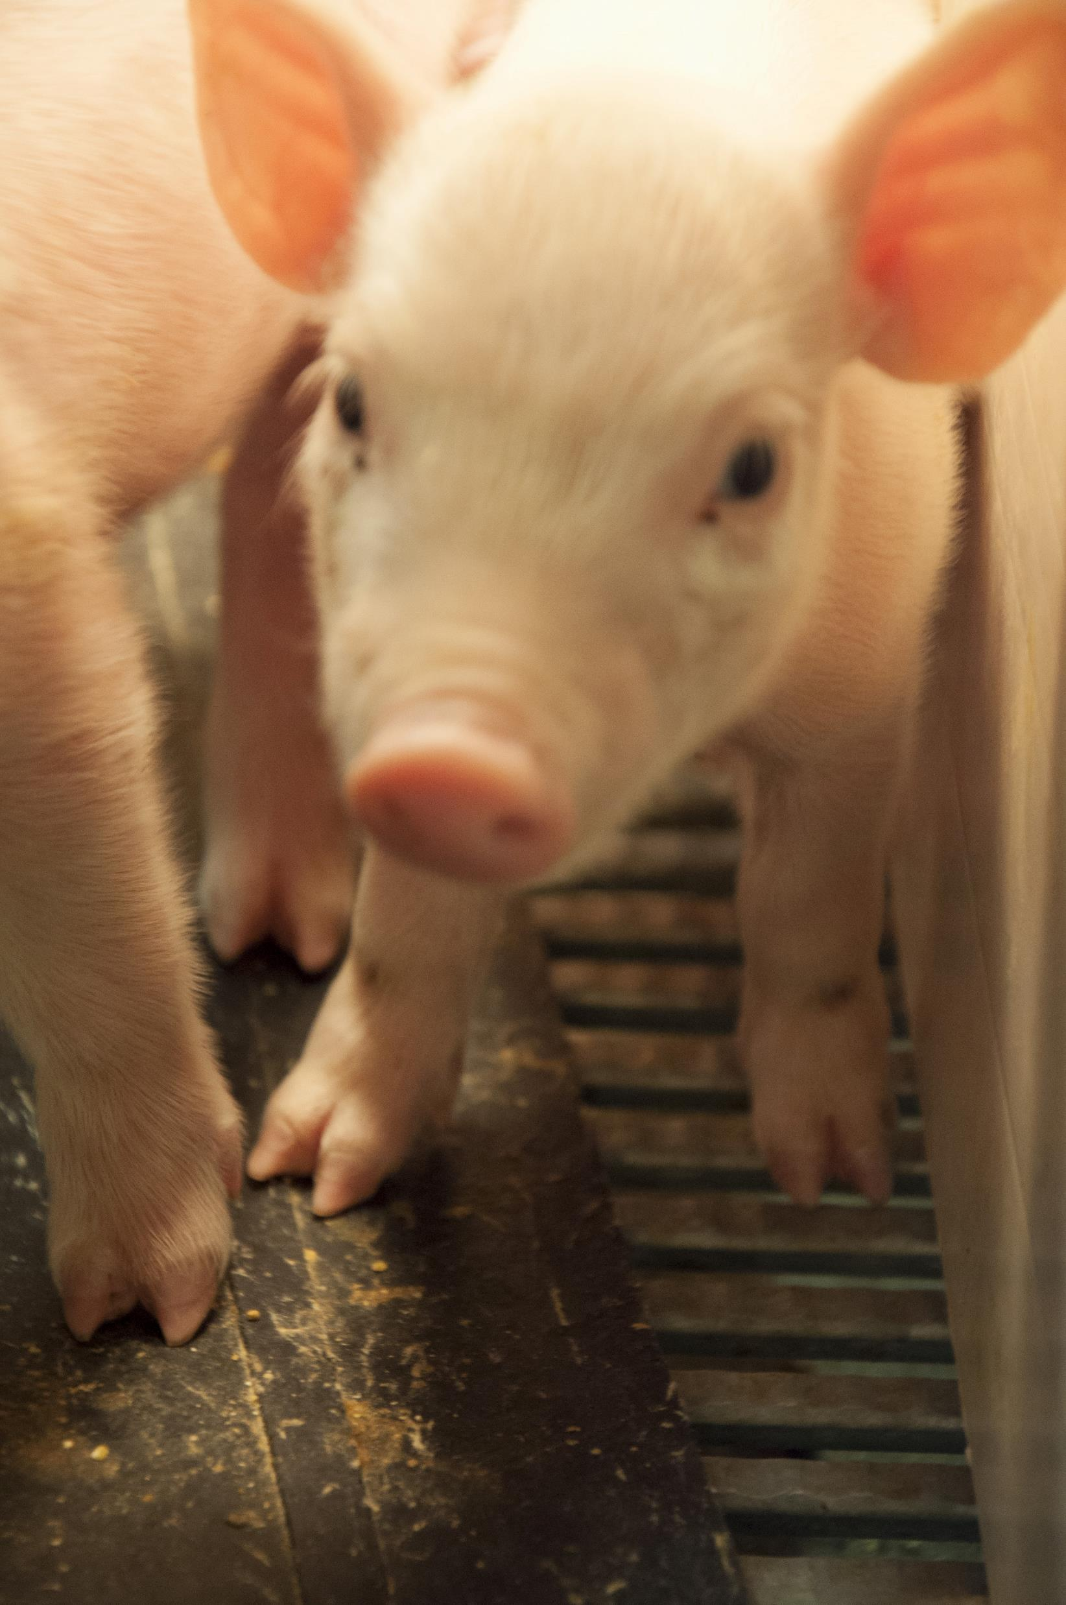
Pipestone Sow Farm
5 Buildings that are engineered with the newest technology
Gestation
Farrowing
Gilt growing barn
Compost
Small storage shed

Slide 11
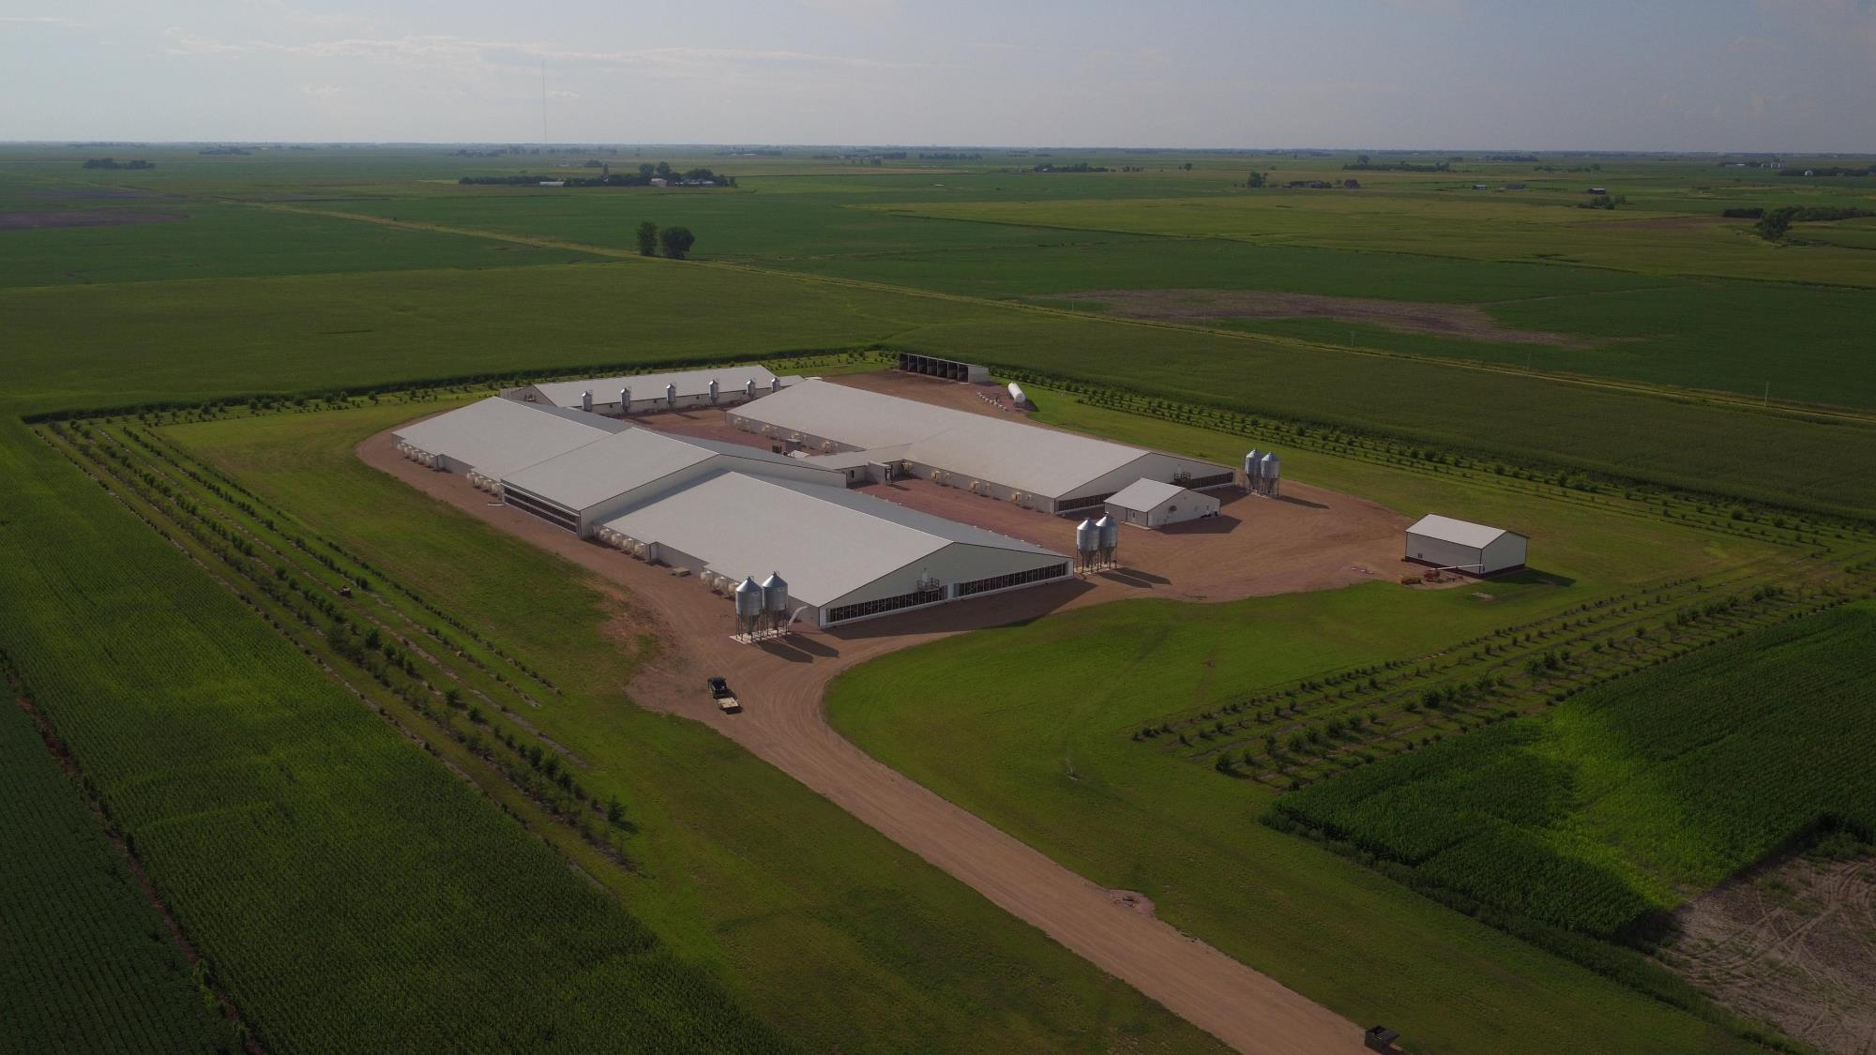
Thunder Ridge - 5400

Slide 12
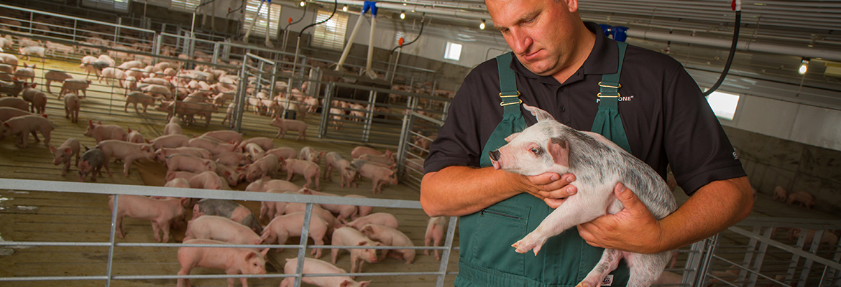

Slide 13
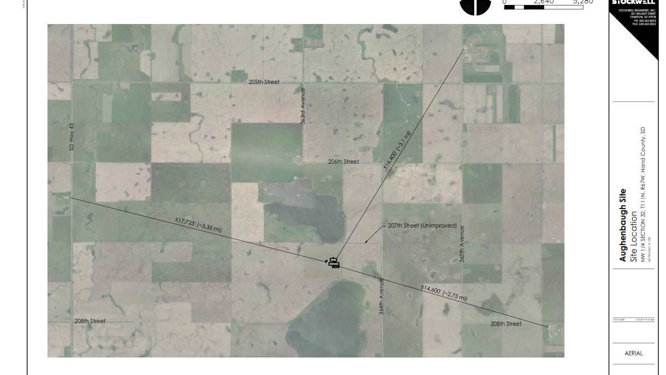

Slide 14
Pipestone Farm Nutrient Management Plan
$170,000 nutrient value created annually by the natural nutrients from the farm
Will provide enough nutrients for approximately 1,200 acres
This nutrient management plan will include 2,000 acres
Plans are approved and regulated by the State of South Dakota
Nutrients will be provided to local land owners
Manure will be incorporated into the soil for maximum nutrient uptake

Slide 15
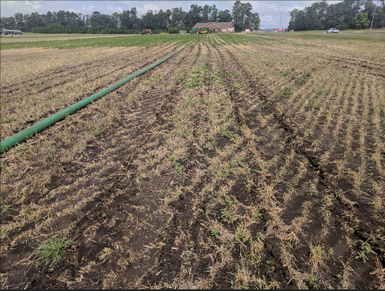
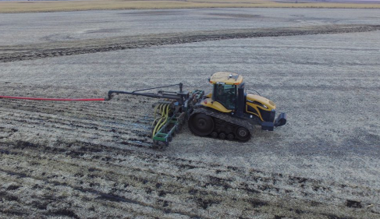
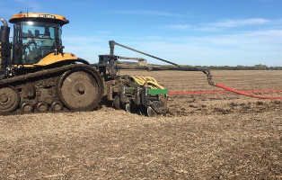
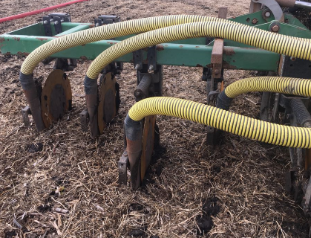
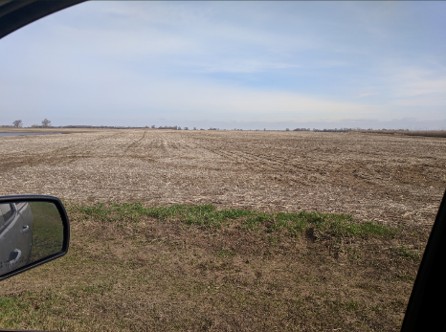
Preferred method—drag hose line
*Many different tool bar applications and field disturbance
*No-till type application and conventional till applications
*Less traffic on roads—safer application method
*Very reliable method of manure application

Slide 16
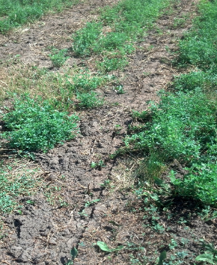
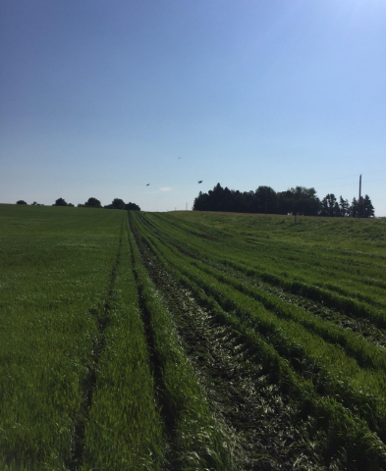
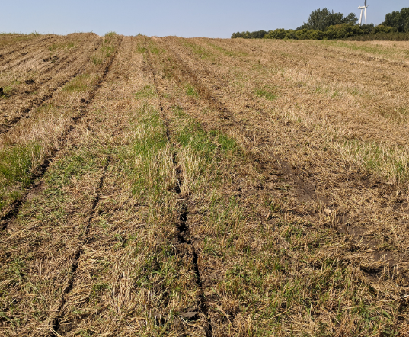
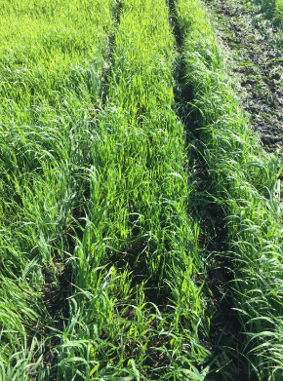
No-till type application—drag hose line or tankers
*More and more manure being applied with this method
*Can apply on alfalfa, grass, cover crop and pastures
* Approved method with the SD DENR
Alfalfa/Grass
Cover crop application
No-till on wheat stubble

Slide 17
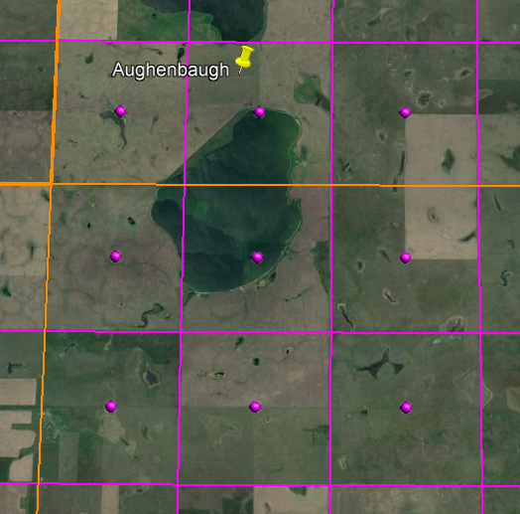

Slide 18
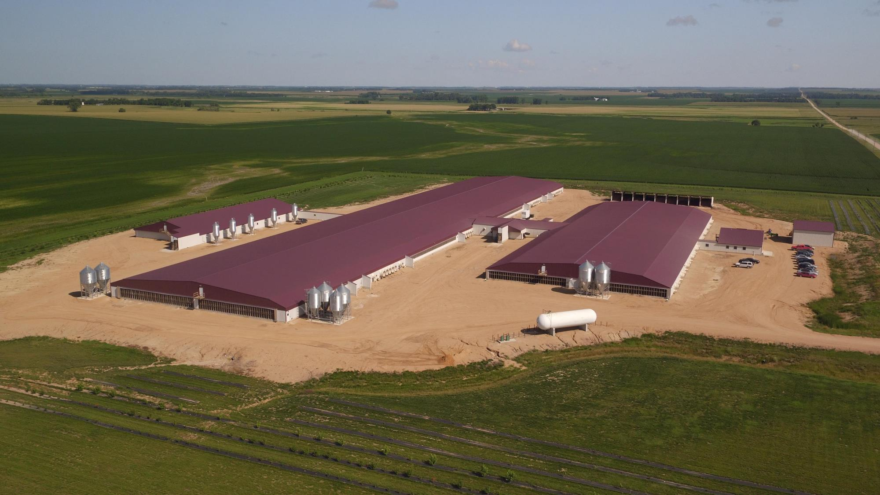
Kodiak Pork - 5800

Slide 19
Cafeteria and break room in our farms

Slide 20
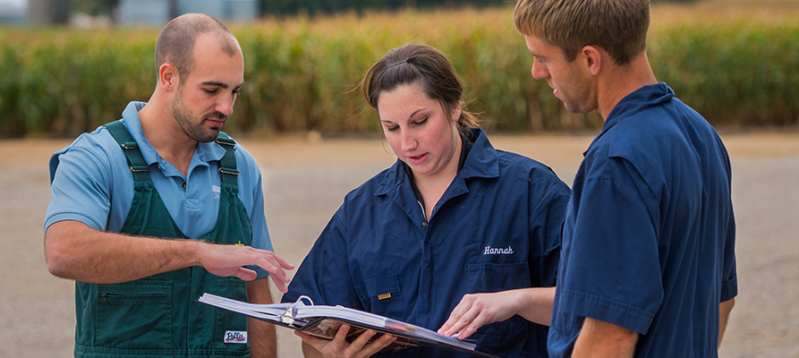
Benefits to the South Dakota Communities
Estimated State and Local economic impact totaling nearly $3,000,000 annually:
Employee base and $1,268,000 annual payroll
Feed purchased locally at approximately $1,300,000 per year
Grain user of approximately 180,000 of corn and 30,000 bu. of soybeans
Assuming 150 bu/ac. corn yield, 1200 acres
40 bu./ac. soybean yield, 750 acres
Utilities purchased locally valued at approximately $216,000 per year
Other vendors include phone service, fuel, lawn care, snow removal, etc.
Nutrient application costs are approximately $130,000
Approximately $170,000 in nutrient value to the farmers
Property Taxes
State sales and excise tax to build the project will be approximately $485,000
Example: 5700 head sow farm

Slide 21
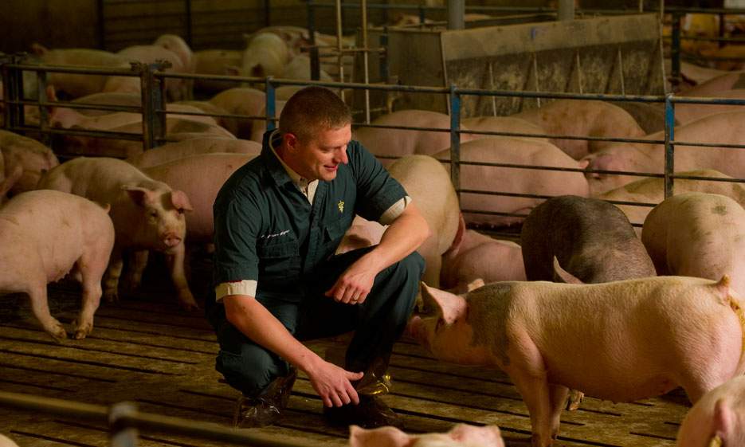
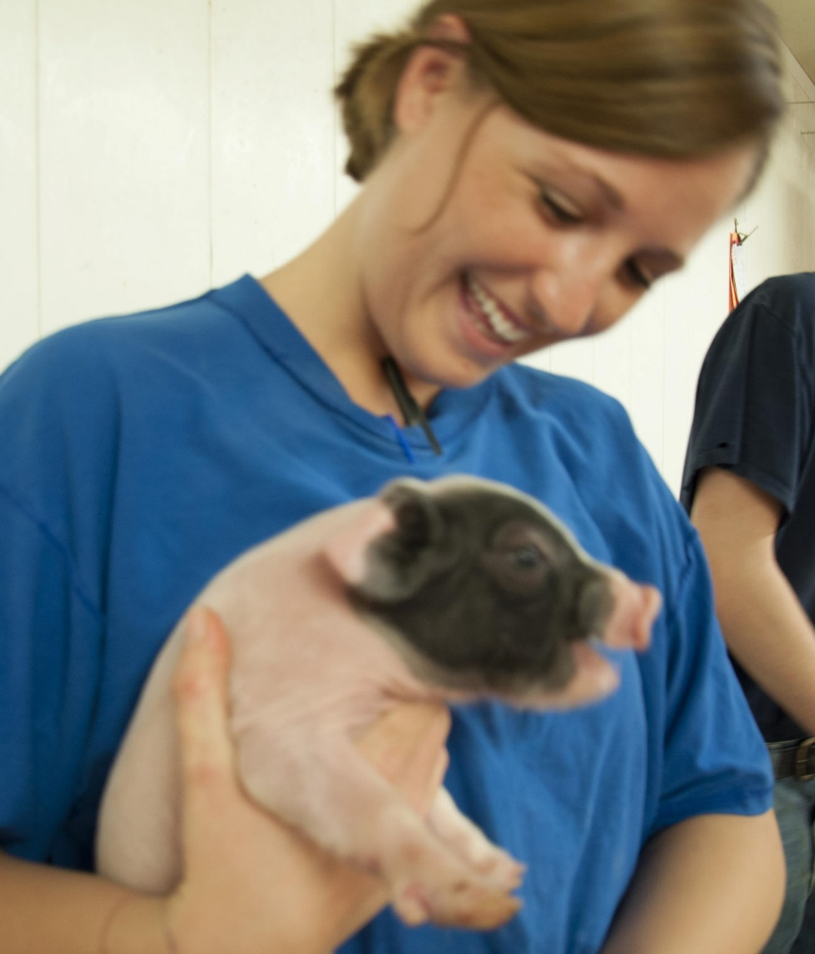

Slide 22
Indirect Benefits
18 full time employment opportunities
Purchasing groceries, restaurant services, housing, utilities, increasing tax revenue, and health care
Other utilities and services used on the farm
Feed purchases increasing local demand for grains rather than relying on exports

Slide 23
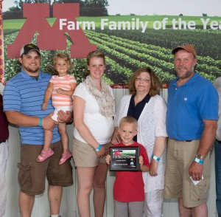
Summary
Pipestone sow unit projects are designed to improve farmers competitiveness in today’s global market.
Owned by independent family farms
Provide good jobs with career paths in agriculture for folks in rural communities
Organic nutrients improve local farmer’s yields and cost efficiency
Improve local grain basis for farmers
Increase local and state tax revenues

Slide 24
Community Involvement
Pipestone Cares Program donated $100,000 to our farms’ communities last year alone.
Over the last two years, Pipestone’s “Give a Helping Ham” campaign has given 150,000 lbs of pork to Feeding South Dakota
https://www.ksfy.com/content/news/68K-pounds-of-pork-donated-to-Feeding-South-Dakota-502729691.html

Slide 25
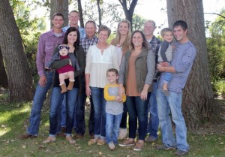
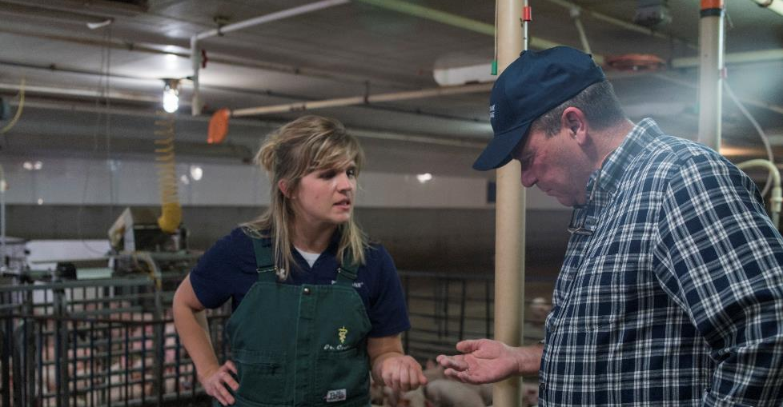
Pipestone’s Why…

Slide 26
Questions
Nick Fitzgerald
(319)631-9316
Nick.fitzgerald@pipestone.com
Marty Rost
(507) 215-0482
Marty.rost@pipestone.com

